Slide 1

EdTech company
Analysis

Slide 2
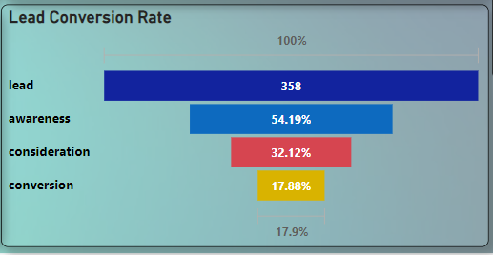
Lead's journey and stages
Lead - Awareness - Consideration - Conversion
Average_Conversion_Rate_Lead_to_Conversion-17.77
This average conversion rate of 17.77% can serve as a benchmark against which future performance can be measured. Monitoring and improving conversion rates is crucial for optimizing marketing and sales efforts, identifying successful strategies, and ultimately increasing the number of enrolled users for the EdTech company.

Slide 3
Business heads to understand their team performance
Months | Total Leads
1 | 272
2 | 86
3 | 1
The data shows that 272 leads were generated in the first month, followed by 86 leads in the second month. This indicates a relatively high level of lead generation initially, followed by a decrease in the second month. Monitoring monthly lead generation helps assess marketing effectiveness, allocate resources, and make data-driven decisions for business growth.
The data provided showcases the performance of junior sales managers in acquiring enrolled users for the EdTech company. The numbers vary across managers, indicating differences in their effectiveness. Some managers have achieved higher numbers of enrolled users, highlighting their strong performance and potential to serve as role models. Others have lower counts, suggesting areas for improvement and the need for additional support or training. By fostering knowledge sharing, providing training opportunities, conducting performance reviews, and implementing incentives, the company can enhance overall sales performance and increase the number of enrolled users.

Slide 4

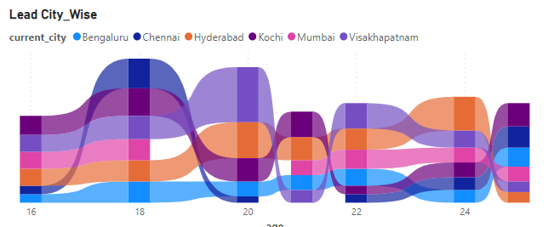
Managers to understand their target areas
To summarize, the analysis reveals that Hyderabad has a higher number of leads followed by Visakhapatnam. To capitalize on this, the company should focus on generating more leads from Hyderabad while also exploring opportunities in Visakhapatnam and others cities also. Targeted marketing efforts, localized advertising, partnerships with local influencers, referral programs, and market research can help increase lead generation in these cities. The company should track and analyze results to make data-driven decisions and continuously refine strategies for maximum lead acquisition success.
Age Wise

Slide 5
Suggestions for the company to consider
Optimize Marketing Strategies: Continuously evaluate and optimize marketing strategies in Different-2 Cities. This can include analyzing the effectiveness of different channels, refining messaging based on customer preferences, and leveraging local influencers or industry experts to amplify reach and engagement
Referral Programs and Incentives: Implement referral programs in both Chennai and Visakhapatnam to encourage existing customers and leads to refer others. Offering incentives for successful referrals can help drive lead generation and expand the customer base.
Collaboration with Sales Team: Foster collaboration between the marketing and sales teams to ensure effective lead nurturing and conversion. Align strategies and share insights to optimize the lead journey and improve conversion rates.
Try to focus on getting more leads from others sources then chances of Conversion is more and sale also increases itself.
Thank You

